Slide 1
Voice Conversion with CycleGAN
Kevin (Yuanxi) Sun
08.23.2019

Slide 2
What is GAN
Generative adversarial networks

Slide 3
What is GAN
…a new framework for estimating generative models via an adversarial process.
…we simultaneously train two models: a generative model G that captures the data distribution, and a discriminative model D that estimates the probability that a sample came from the training data rather than G.
The training procedure for G is to maximize the probability of D making a mistake. This framework corresponds to a minimax two-player game. In the space of arbitrary functions G and D, a unique solution exists, with G recovering the training data distribution and D equal to 1/2 everywhere.
Generative Adversarial Nets Ian J. Goodfellow et al. 2014

Slide 4
What is GAN
Binary Classification
Discriminator
Generated Samples
Generator
Forward
Backward
Input Vectors
Real Samples

Slide 5
CycleGAN
Generative model without paired data

Slide 6
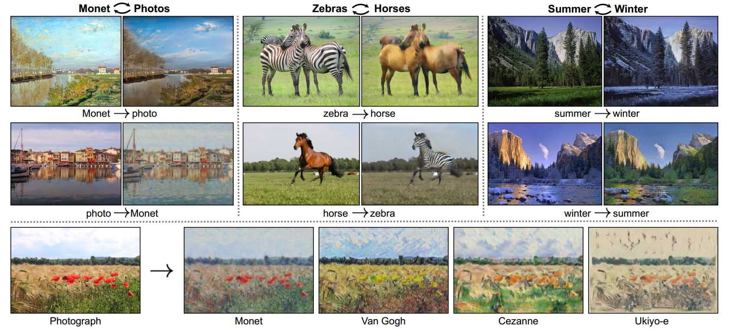
CycleGAN
Jun-Yan Zhu et al. 2017

Slide 7
CycleGAN
Cycle-Consistency Loss:
Given unpaired data X and Y
G: X -> Y is a mapping that transform X to Y, and F: Y -> X
We want F(G(x)) ≈ x, G(F(y)) ≈ y
L_{cyc} = L(X, F(G(X))) + L(Y, G( F(Y) ) )
So: L = L_{gan}(G) + L_{gan}(F) + L_{cyc}(G, F)
G
X
Y
F

Slide 8
Voice Conversion with CycleGAN
Parallel-Data-Free Voice Conversion Using Cycle-Consistent Adversarial Networks
Takuhiro Kaneko et al. 2017

Slide 9
CycleGAN for Audio
Preparation
VCC2016 Dataset, University of Edinburgh
Voice Conversion Challenge (VCC) 2016, paired data contains 162 utterances for training and 54 utterances for evaluation from each of 5 source and 5 target speakers.
LibROSA: package to extract the Short-Time Fourier Transform(STFT), and Mel-Frequency Cepstral Coefficients (MFCC) from the audio.
PyWorld package
PyWorldVocoder, a Python wrapper for world vocoder. It can decode a speech into spectral envelope and resynthesize the speech from these features.

Slide 10
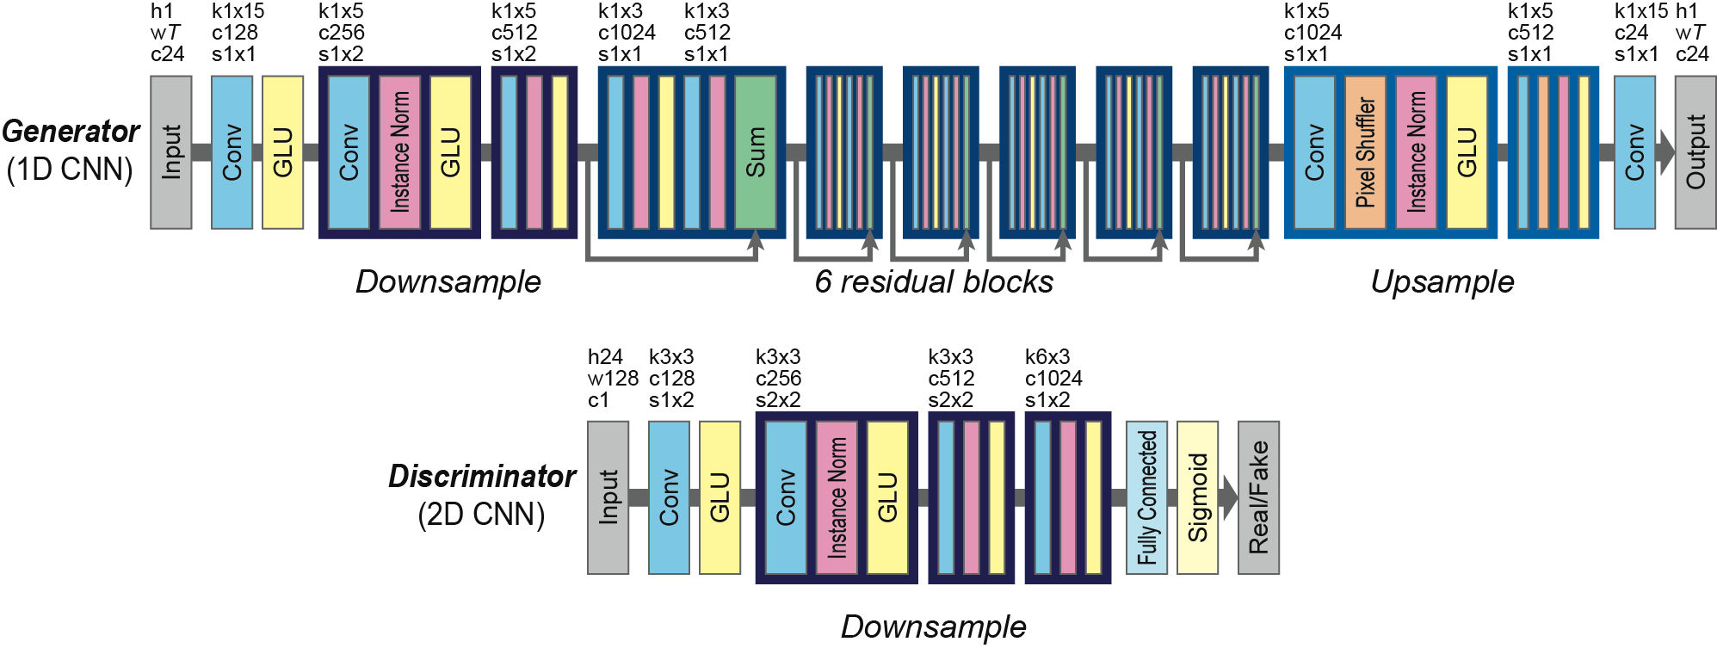
CycleGAN for Audio
Parallel-Data-Free Voice Conversion Using Cycle-Consistent Adversarial Networks
Takuhiro Kaneko et al. 2017

Slide 11
Residual Block & GLU
Gated Linear Units
x
GLU is a data-driven activation function
i.e. The output of H_{k+1} is depend on H_{k}:
H_{k+1} = (W * H_{k} + b) ⊗ σ(V * H_{k} + c)
⊗: componentwise multiplication
σ : sigmoid function
This is being used in Gated CNN for processing sequential data with CNN instead of RNN due to its difficulty of parallel implementation.
Yann N. Dauphin et al. 2017
Weight layer
F(x)
ReLU
Weight layer
F(x) + x
+
ReLU
Kaiming He el al. 2015

Slide 12
Identity Mapping Loss
L_{id}(G_{x->y}, G_{y->x}) = E_{y}[|G_{x->y} (y) - y|] - Ex[|G_{y->x} (x) - x|]
This means that our generator should preserve the information of audios.
So if we give G_{x->y} the audio y, the output should still sound the same as y, and vise versa.

Slide 13
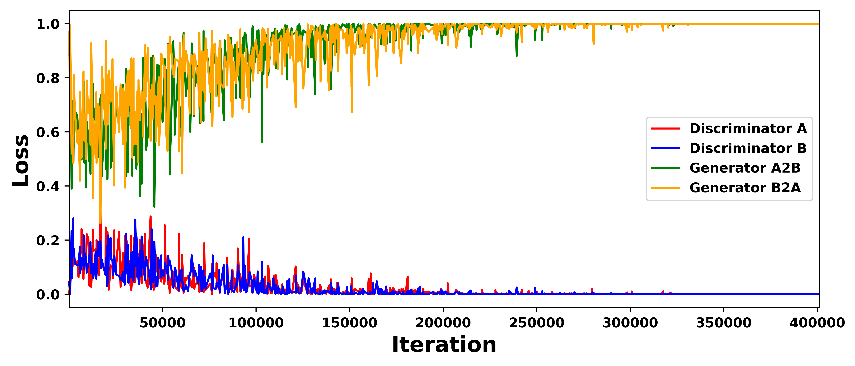
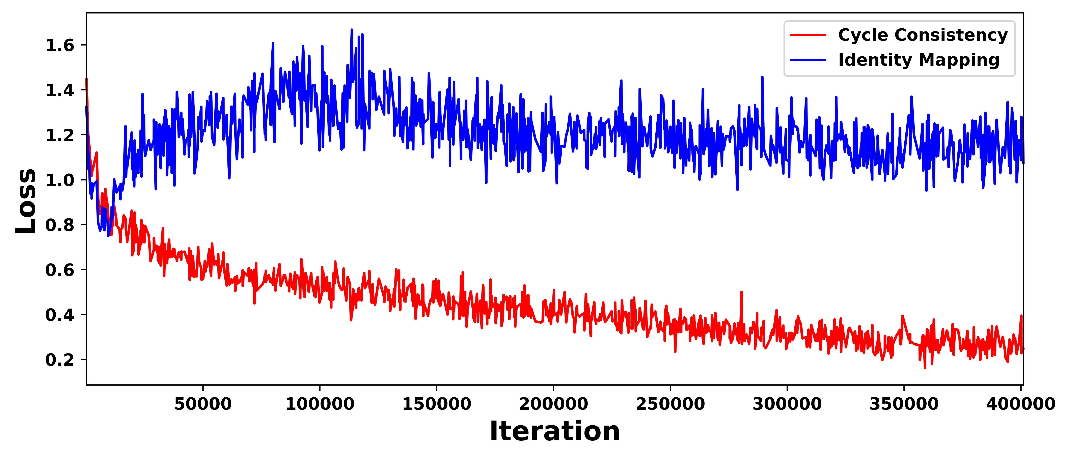
Training Results
L_{id}
Y
Y
G_{x->y}
X
Y’
D_{y->x}
D_{x->y}
X’
Y
G_{y->x}
X
X
L_{adv}
L_{id}
L_{adv}
L_{cyc}

Slide 14
Future Works
WHAT WE CAN DO NEXT

Slide 15
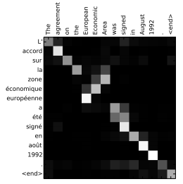
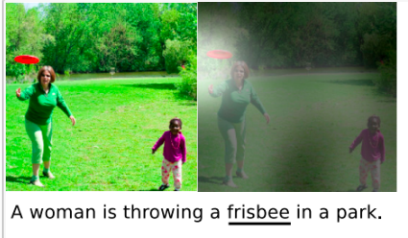
Future Works
Attention Neural Networks
Pretrained model
Reduce the amound of data that Cycle GAN needed.
Pretrained model
Classify different voices into tens of types and train each type of voices.
Classify the voice of our user into one of the classes within just a few sentences, and immediately apply the pretrained model for that class for a pretty good performance.
Bahdanau el al. 2014

Slide 16
Future Works
Improve Identity Loss
Currently in this paper, they use L1 loss, or absolute loss to make sure that the information in the audio remains the same.
Maybe we can actually check these audio pairs by neural nets, or even by the feature vector inside our Generator, which should be much applicable.
CycleGAN-VC2: Improved CycleGAN-Based Non-Parallel Voice Conversion
Takuhiro Kaneko et al. 04.09.2019

Slide 17
Voice Conversion with CycleGAN

